Slide 1
Health Economics
Chapter 12:
Managed Care

Slide 2
What is Managed Care?
Insurance companies and health care providers cooperate to provide comprehensive health care
Usually employer-based
Created to contain costs
Subscribers are given financial incentives to use “in-network” care.

Slide 3
Managed Care Alphabet Soup
Each type of Managed Care Organization (MCO) provides insurance, but they differ on how care is delivered and organized.
FFS: Fee-For-Service (a.k.a. Indemnity policies)
Managed care antithesis
Insured are offered defined coverage for services provided
Very few, if any, constraints on provider or insured’s choices.
HMO: Health Maintenance Organization
Traditionally completely vertically integrated (“staff model”)
Provides a group with health care in return for a capitation fee – a fee based on group size.
Patients must use plan-affiliated providers.
Specialist care requires referrals from a “gate-keeper.”

Slide 4
ABCs of Managed Care, cont.
2.b IPA: Independent Practice Association
A form of HMO where
the HMO contracts with a network of individual providers rather than hiring them directly and
the providers are free to contract with multiple HMOs and see patients on a FFS basis.
POS: Point of Service
Like an HMO except that customers may see out-of-network providers.
No restrictions on out-of-network care, but coverage is less generous. (“two-tiered”)
There is still a gatekeeper for in-network care.

Slide 5
ABCs of Managed Care, cont.
4. PPO: Preferred Provider Organization
“Two-tiered” like a POS plan where coverage is more generous for in-network care.
No gatekeeper

Slide 6
Summary
 | Gatekeeper? | Out-of-Network Care subsidized?
HMO | Yes | No
POS | Yes | Yes
PPO | No | Yes
FFS | No | N/A

Slide 7
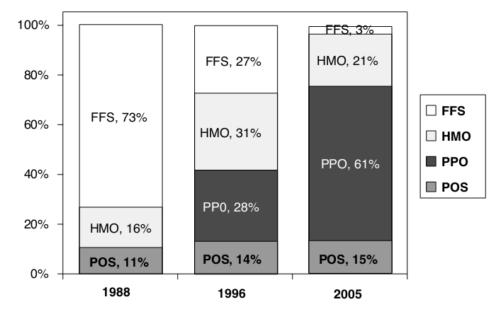
Workers’ Health Plan Enrollment

Slide 8
Why Managed Care?
Managed care mitigates problems associated with
Moral hazard (on both consumer and provider side)
Principal-Agent problem
Cost containment (partially?) passed on to consumer through lower fees.
The consumer trades off less flexibility with lower premiums.

Slide 9
Managed Care Organization’s (MCO’s) Cost Containment Strategies
[A] Interventions on Consumer Side
1. The gatekeeper model: The patient must see and obtain a referral from a primary care physician (PCP) before seeing a specialist.
PCP care is less expensive because
PCPs usually receive a lower fee than specialists.
Specialists tend to use costlier medical resources.
Some health care needs can be addressed by a PCP or a specialist.
The gatekeeper prevents the patient from bypassing the PCP.

Slide 10
Cost Containment Strategies, cont.
2. Copayments and Deductibles Like coinsurance, but the portion a patient pays for service is fixed instead of a percentage of fee.
In most cases, copayments are small ($5-$25); reduce moral hazard
Second Opinion Programs The plan offers second opinions before paying for surgery.
Designed to mitigate problems of supplier-induced demand (problem in FFS programs)
The second-opinion provider cannot offer to perform other services for patient (removes financial incentives).
3 things work against these programs
Patients reluctant to “challenge” doctor.
2nd opinion will usually come from a doctor in the same geographic area (Small Area Variation)
The incentives to not give a fully honest opinion are not eliminated (dynamic interaction – tit-for-tat)

Slide 11
Cost Containment Strategies, cont.
[B] Interventions on Provider Side
Payment strategies for doctors
Fee-for-Service versus Salary Salaried doctors are more likely to provide restricted but adequate care. E.g., they are less likely to recommend hospitalization
Holdbacks – A portion of the salary is held back. If the plan comes in at or under target costs, the holdback is dispersed to all the doctors.
Provider Selection
MCOs select lower cost providers – enhances competition among providers
Prices and Fee Schedules (bargaining)
Negotiate lower prices with providers in return for offering them a higher volume of patients without “advertising.”

Slide 12
Cost Containment Strategies, cont.
[C] Interventions in Specific Treatment Outcomes
Prior Authorization
Patients must receive the OK from the plan before some expensive interventions (e.g., surgery, hospitalization, major diagnostic tests)
Often authorization is routinely granted, but it prevents “could have beens”
Also provides a non-monetary hurdle – another way to identify consumer valuation of services other than price
Denial of Payment
Makes physicians and patients cautious about using treatments that are at a higher risk of denial of payment.
Credibility

Slide 13
Cost Containment Strategies, cont.
[D] Miscellaneous
Input Efficiency
Some patients require several stages of treatment
Staff model HMOs have control over all inputs to treatment and have all the financial incentive to control costs because of capitation fees
“Cream-skimming” Finding ways to attract low risk people
Discounts for gym memberships
Vision benefits (young are more likely to see eye doctors)
Tattoo removal!
Prevention

Slide 14
Cost Containment Strategies: Summary
Consumer side
The gatekeeper model
Copayments (and deductibles)
Second opinion programs
Provider side
Physician payment (FFS versus annual and holdbacks)
Provider Selection
Prices and Fees (bargaining power)
Treatment Outcomes
Prior authorization
Denial of Payment
Miscellaneous
Input efficiency
“Creaming-skimming”
Prevention

Slide 15
Empirical Questions
Relative to FFS, do HMOs lower costs?
HMO, PPO, and POS plans may be a way to price discriminate.
Do HMOs offer less care to patients (``skimping’’)?
If so, is this care sub-optimal – or do FFS plans offer “too much” care?
Incentives and Empirical Issues
Since HMOs are paid on a capitation basis, they have a greater incentive to:
Eliminate unnecessary treatment
Emphasize preventive care vs. more expensive curative care
Does this result in “skimping”?
Selection bias: “Creaming” and “dumping”
A naïve study may falsely conclude that HMOs are more cost effective if they ignore this bias.
HMOs are paid fixed rates per person irrespective of the amount of treatment used.

Slide 16
Empirical Questions, cont.
Do HMOs lower costs?
Altman, et. al. (2000):
Costs roughly 40% lower per patient relative to FFS.
Half the difference due to lower incidence of disease (selection bias or better prevention)
The other half attributed to paying lower prices for the same care (bargaining power in price negotiations)
The RAND study
Random assignment so selection bias eliminated.
Patients assigned to FFS with varying coinsurance rates or Group Health Insurance (GHC)
Total expenditure per person were $439 in GHC group vs. $609 for free care FFS group.
Differences due primarily to hospital admission rates and length of stay in hospitals.

Slide 17
Empirical questions, cont.
Do HMOs provide less care?
The evidence is mixed
Lower rates of admission to hospitals and shorter stays is a fairly robust finding
Diagnostic screening is about the same
Some studies have even found a greater intensity of treatment for patients in HMOs – due to emphasis on preventive care? I.e., once illness strikes, it is more likely to be severe.
Is HMO care sub-optimal?
Very tough question – what is optimal?
Recall study comparing pediatric care between FFS and salaried doctors .

Slide 18
Review of Literature: Miller and Luft, Health Affairs (2002)
Indicator | Favorable to HMOs | Mixed | Unfavorable to HMOs | Total
Quality of Care | 14 | 18 | 15 | 47
Access to Care | 2 | 4 | 4 | 10
Satisfaction | 0 | 3 | 8 | 11
Prevention | 7 | 3 | 0 | 10
Length of stay | 5 | 5 | 0 | 10
Expensive resources | 8 | 7 | 0 | 15

Slide 19
Supplier Induced Demand (SID)
In a perfect world, any agent would do exactly as the uninformed principle would do if the uninformed had all the necessary information.
However, the physician earns income by treating patients. With certain caveats, the more services they provide, the more money they receive – “fee for service” (FFS)
Could it be that physicians provide more care than is necessary?....more than the patient would demand if they had the same info as the doctor?
Patient report: “First visit to dentist and she didn’t even look at me but wanted to give me a scan that cost $85.”

Slide 20
Optimal vs. Actual Care
Study: Hickson, Altmeier, and Perrin (1987).
Using residents at a university hospital, they randomly assigned half the doctors to receive a FFS payment and half to be paid by flat salary.
Incoming patients were also randomly assigned.
 | FFS | Flat Salary
Scheduled visits | 4.9 | 3.8
Times patient is seen | 3.6 | 2.9

Slide 21
Optimal vs. Actual Care
American Academy of Pediatrics has a schedule of recommended treatment for children, corresponding to “correct” care.
Summary – FFS provide too much care whereas salaried provide too little care.
 | FFS | Flat Salary
Optimal vs. actual | 4% fewer actual | 9% fewer actual
Optimal vs. recommended | More than recommended for 22% of patients. | More than recommended for 4% of patients.

Slide 22


